Slide 1
Load reference data
ercc_and_TPA_mouse_rRNA.fa
  https://www.dropbox.com/s/f76chqyepgi1z07/ercc_and_TPA_mouse_rRNA.fa?dl=0
  May be locally cached
chrom_sizes
  https://www.dropbox.com/s/huc07agfawpd9tp/chrom.sizes?dl=0
  Set filetype to “tabular” (see set filetype slide)
gencode.vM5.annotation.gtf
  https://www.dropbox.com/s/klfoh3ayk4bbnr5/gencode.vM5.annotation.gtf?dl=0
  Check format is gtf (see set filetype slide)
  May be locally cached

Slide 2
  set filetype
Click on “Edit attributes” (pencil) icon for data
Select “Datatype”
Select required type in “New Type” dropdown
  Warning: fastqcsanger != fastqsanger
Save
Click on data name
Check format is now shown correctly

Slide 3
Data
All the tools are designed to run with either individual data files or Dataset collections.
Individual fasta files must have their type changed to fasftqsanger (see set filetype slide)
Directory Data Reader will return a Dataset collection with the type already set correctly
  Assuming done correctly by admin

Slide 4
Get Data Fasta data
Directory Data Reader
  An admin has to add the directory
Run Twice
  String which must be at the end of the file name (excluding the file type)
    R1_001
    R2_001
  Use different output name (that make sense to you)
Use “String which must be at the start of each file name” to get a subset of all files
  Ex “C0” or “C9” to get a few pairs
  Ex “C75 “ or “C66” to get a collection of one file

Slide 5
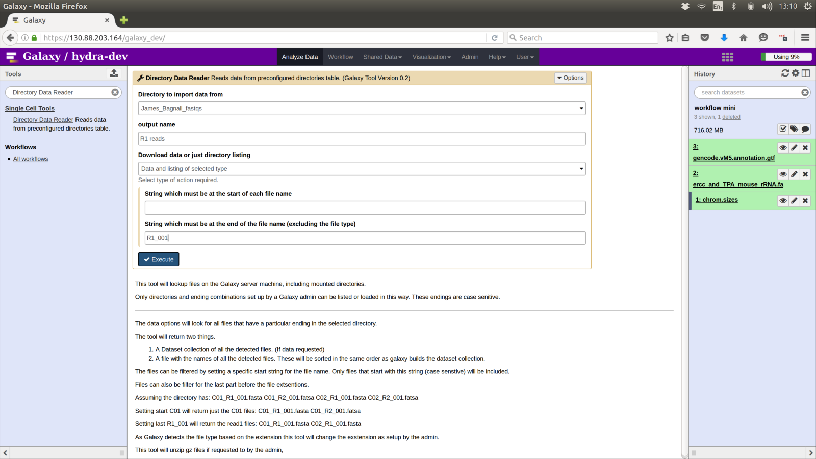

Slide 6
Using Data Collection
For Fasta Data (or upstream versions of that)
When running a tool click on “Data collection” icon (left of the three next to input selector dropdown)
Pick relevant collection
Individual data is hidden
  Can be revealed by clicking on “list of datasets link”
  Or “history options” icon / unhide hidden datasets

Slide 7
Tagdust single end runner
Select Dataset collection based on “R1_001”
No reference
F:NNNNNNNN_S:TATAGGG_R:N achitecture
No barcode files

Slide 8
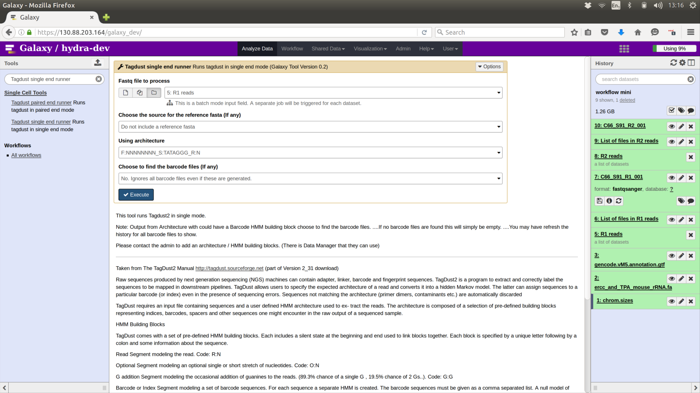

Slide 9
Sync Fastq Pairs
Select Dataset collection “tagdust extracted” ...
Select Dataset collection based on “R1_002”

Slide 10
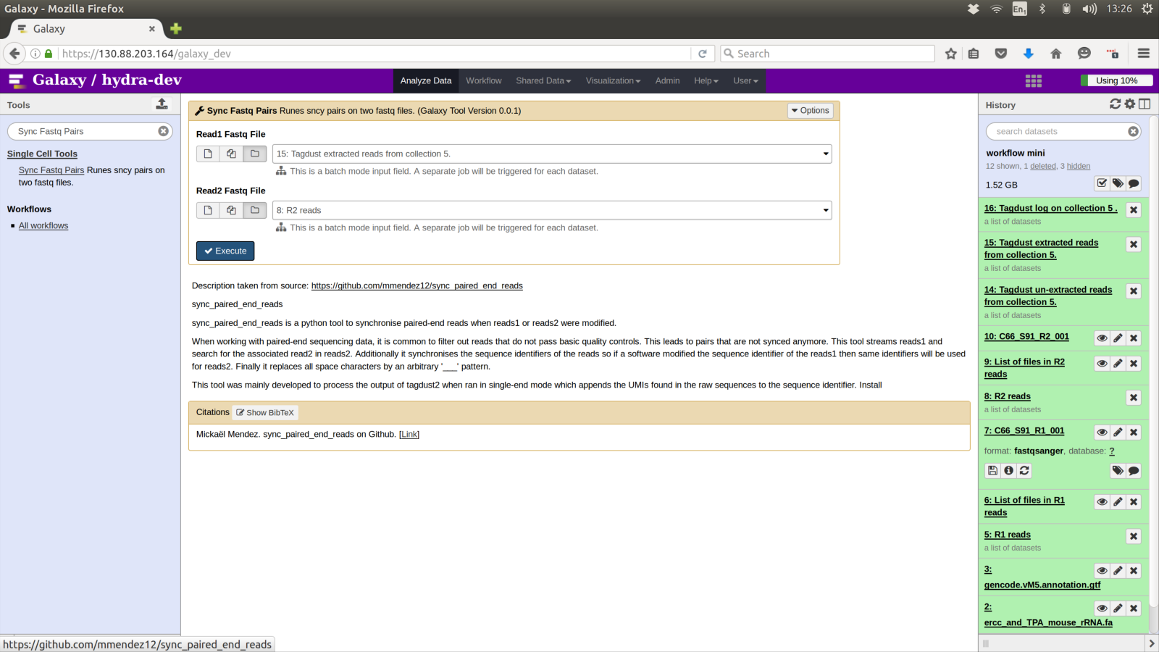

Slide 11
Tagdust paired end runner
Select Dataset Collection Sync Reads 1
Select Dataset Collection Sync Reads 2
Select ercc_and_TPA_mouse_rRNA.fa
  Probably from history
Select R:N architecture
No barcode files

Slide 12
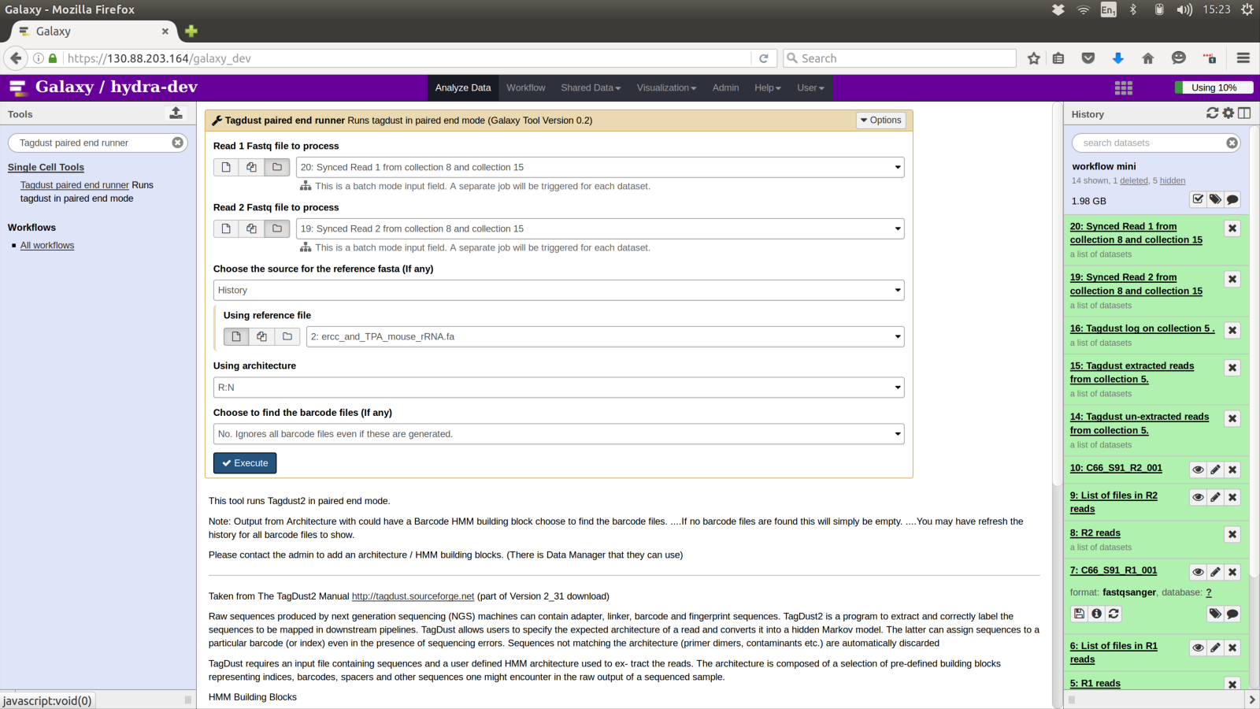

Slide 13
Map with BWA for Illumina
Select mm10_random_chrM_chrUn.fa index
  Needs to be added by an admin
  Could be done with fasta file in history BUT will reindex for EVERY pair.
Select paired end
Select Dataset collection tagdust extracted read 1
Select Dataset collection tagdust extracted read 2
Select commanly used
Select no (do not suppress headers)

Slide 14
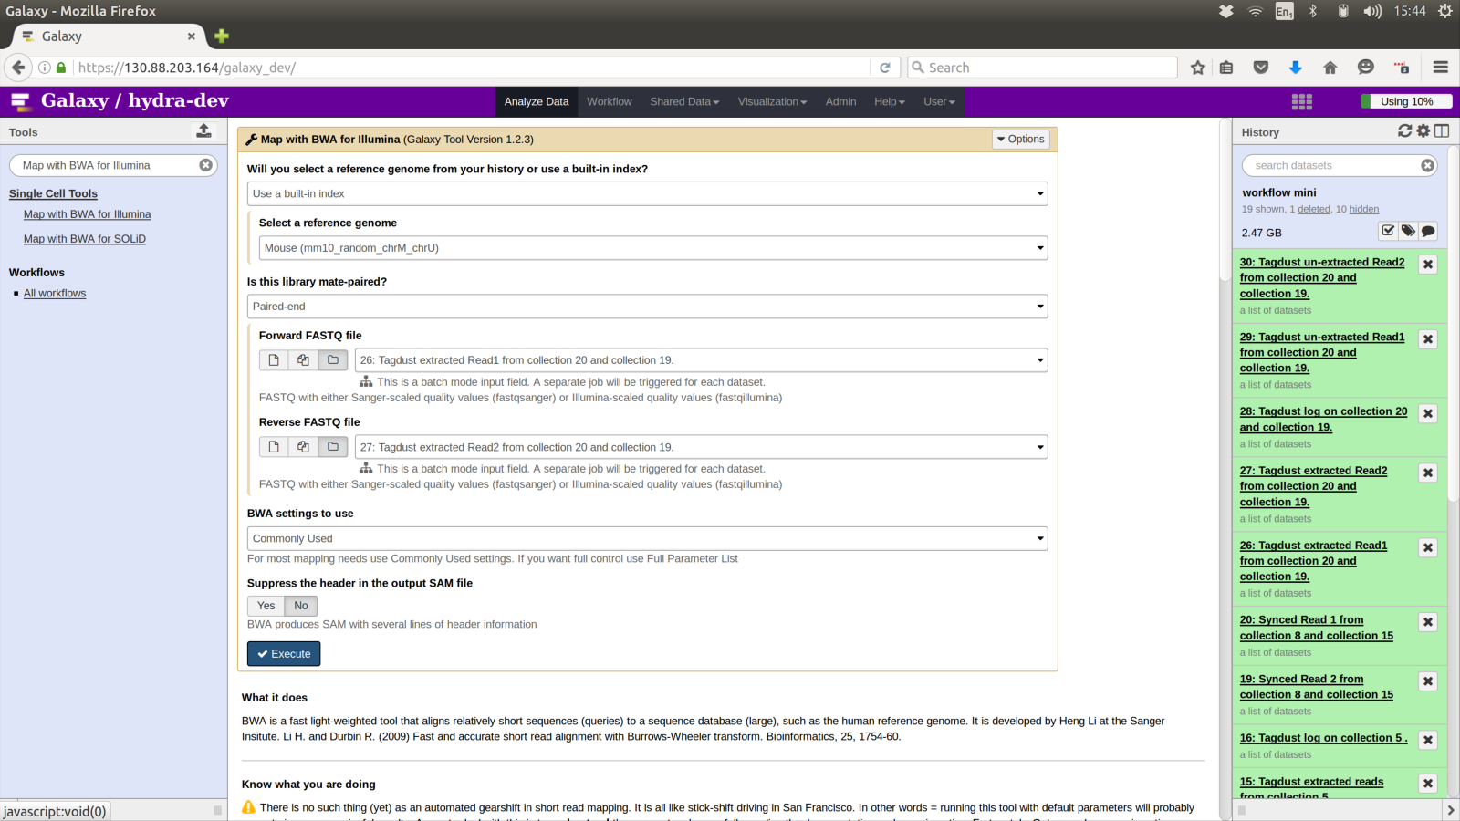

Slide 15
Samtools flag_filter
Select Map with BWA Dataset collection
Insert Flag
  Read is mapped ...0002
  Keep
Insert Flag
  The aligment or this read is not paired … 0100
  Remove

Slide 16
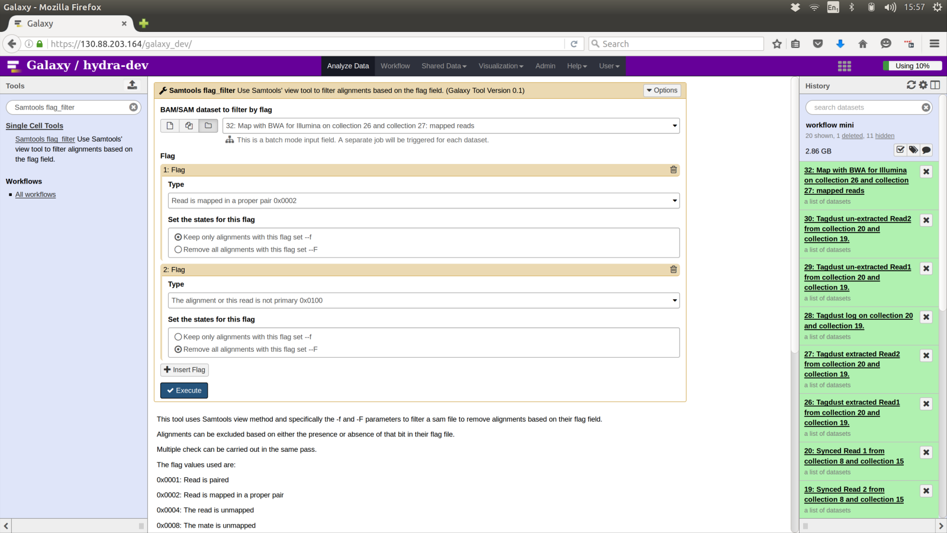

Slide 17
Paired bam to bed12
Select Dataset collection filtered by flag

Slide 18
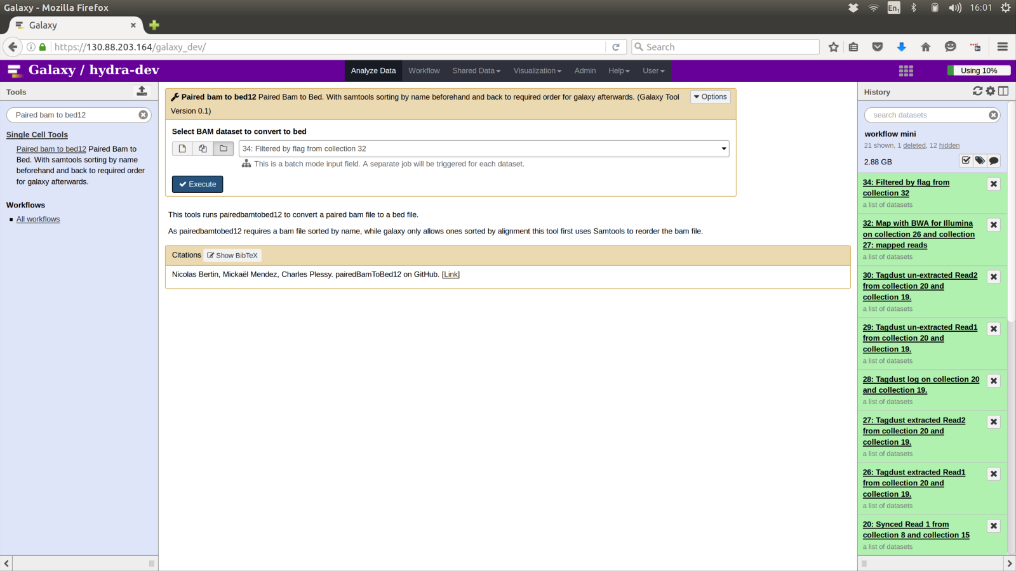

Slide 19
umicount
Select Dataset collection bed12 version

Slide 20
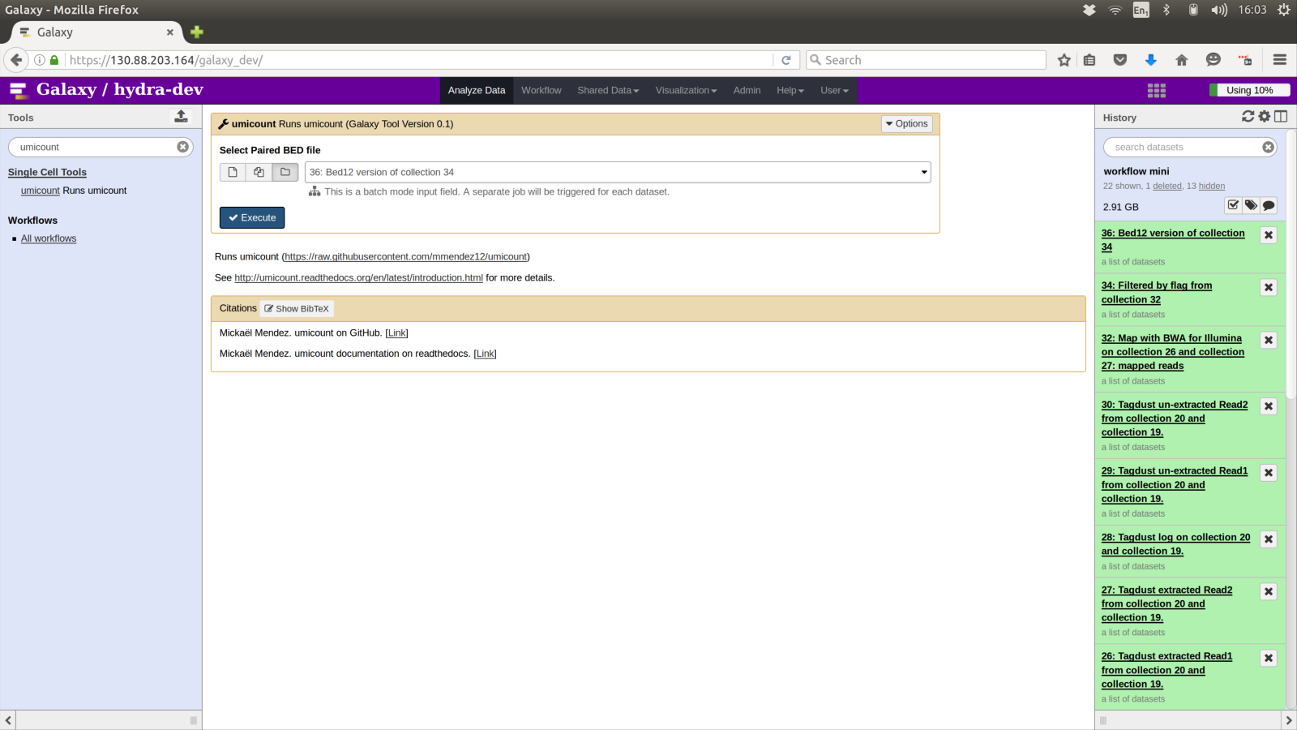

Slide 21
BED to BAM
Ideally use the Bedtools2 tool “BED to BAM“
  However at the time of writing this tool was buggy as it returned bam files in an order Galaxy no longer handles
Use too Paired bam to bed12
  (This is same as above but sorts result)
  Select Dataset collection umicount output
  Unsure of best value for “Indicate that the input BED file is in BED12”
  Genome File: chrome.sizes
    If not in dropdown check it is format tabular
  Set mapping quality : I always used default

Slide 22
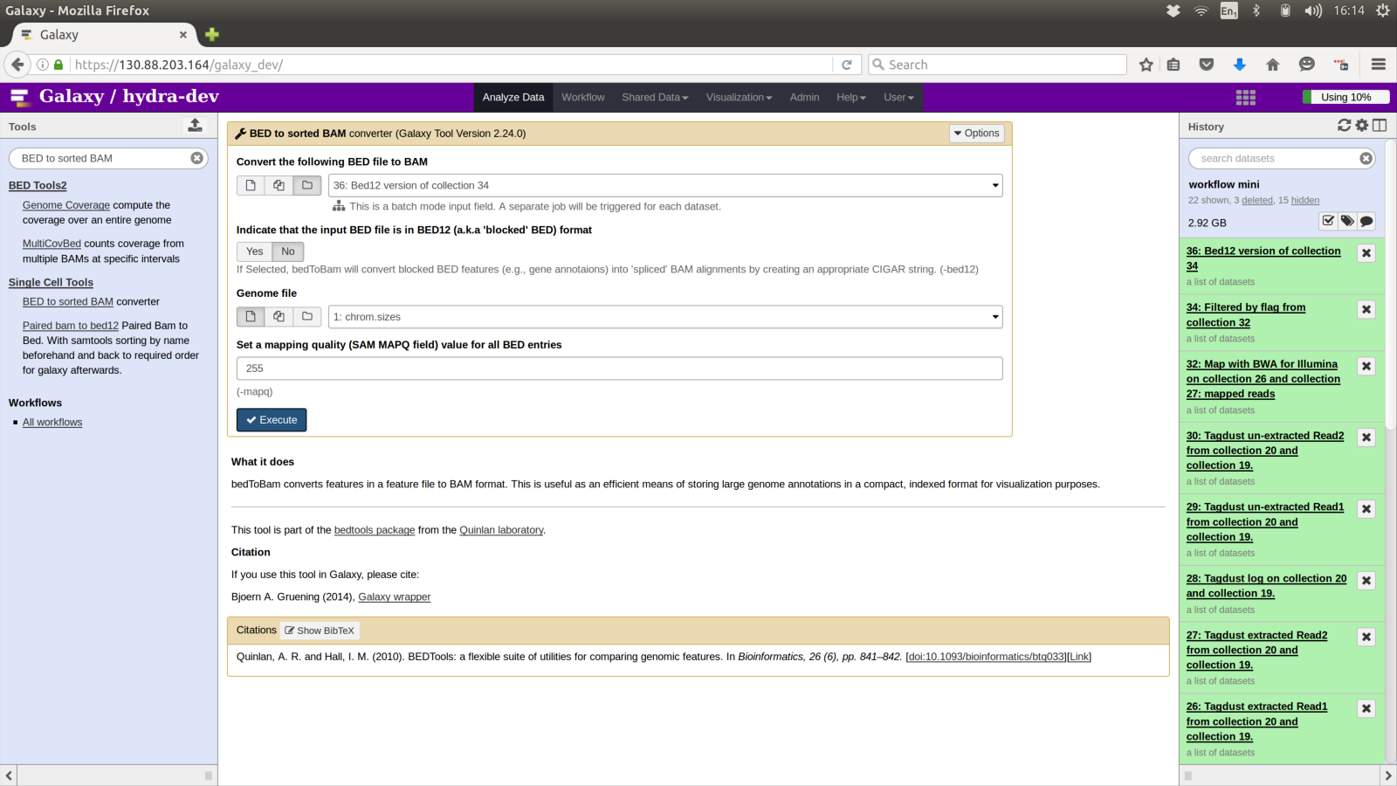

Slide 23
FeatureCount from subread
Select Genome transfer file gencode.vM5.annotation.gtf
  May be locally cached
  If not showing check format is gtf
Select Collection of … file plus file with list of names
Select Dataset collection bed12 version of … as bam
Select list of files in … (one of the directory read jobs)
Add a suitable prefix
  Tool will strip of any string found at the beginning of every file name in the list
    As well as any shared ending
  In this example the C or if applable C66 C9 C0 ext is stripped of

Slide 24
